Slide 1
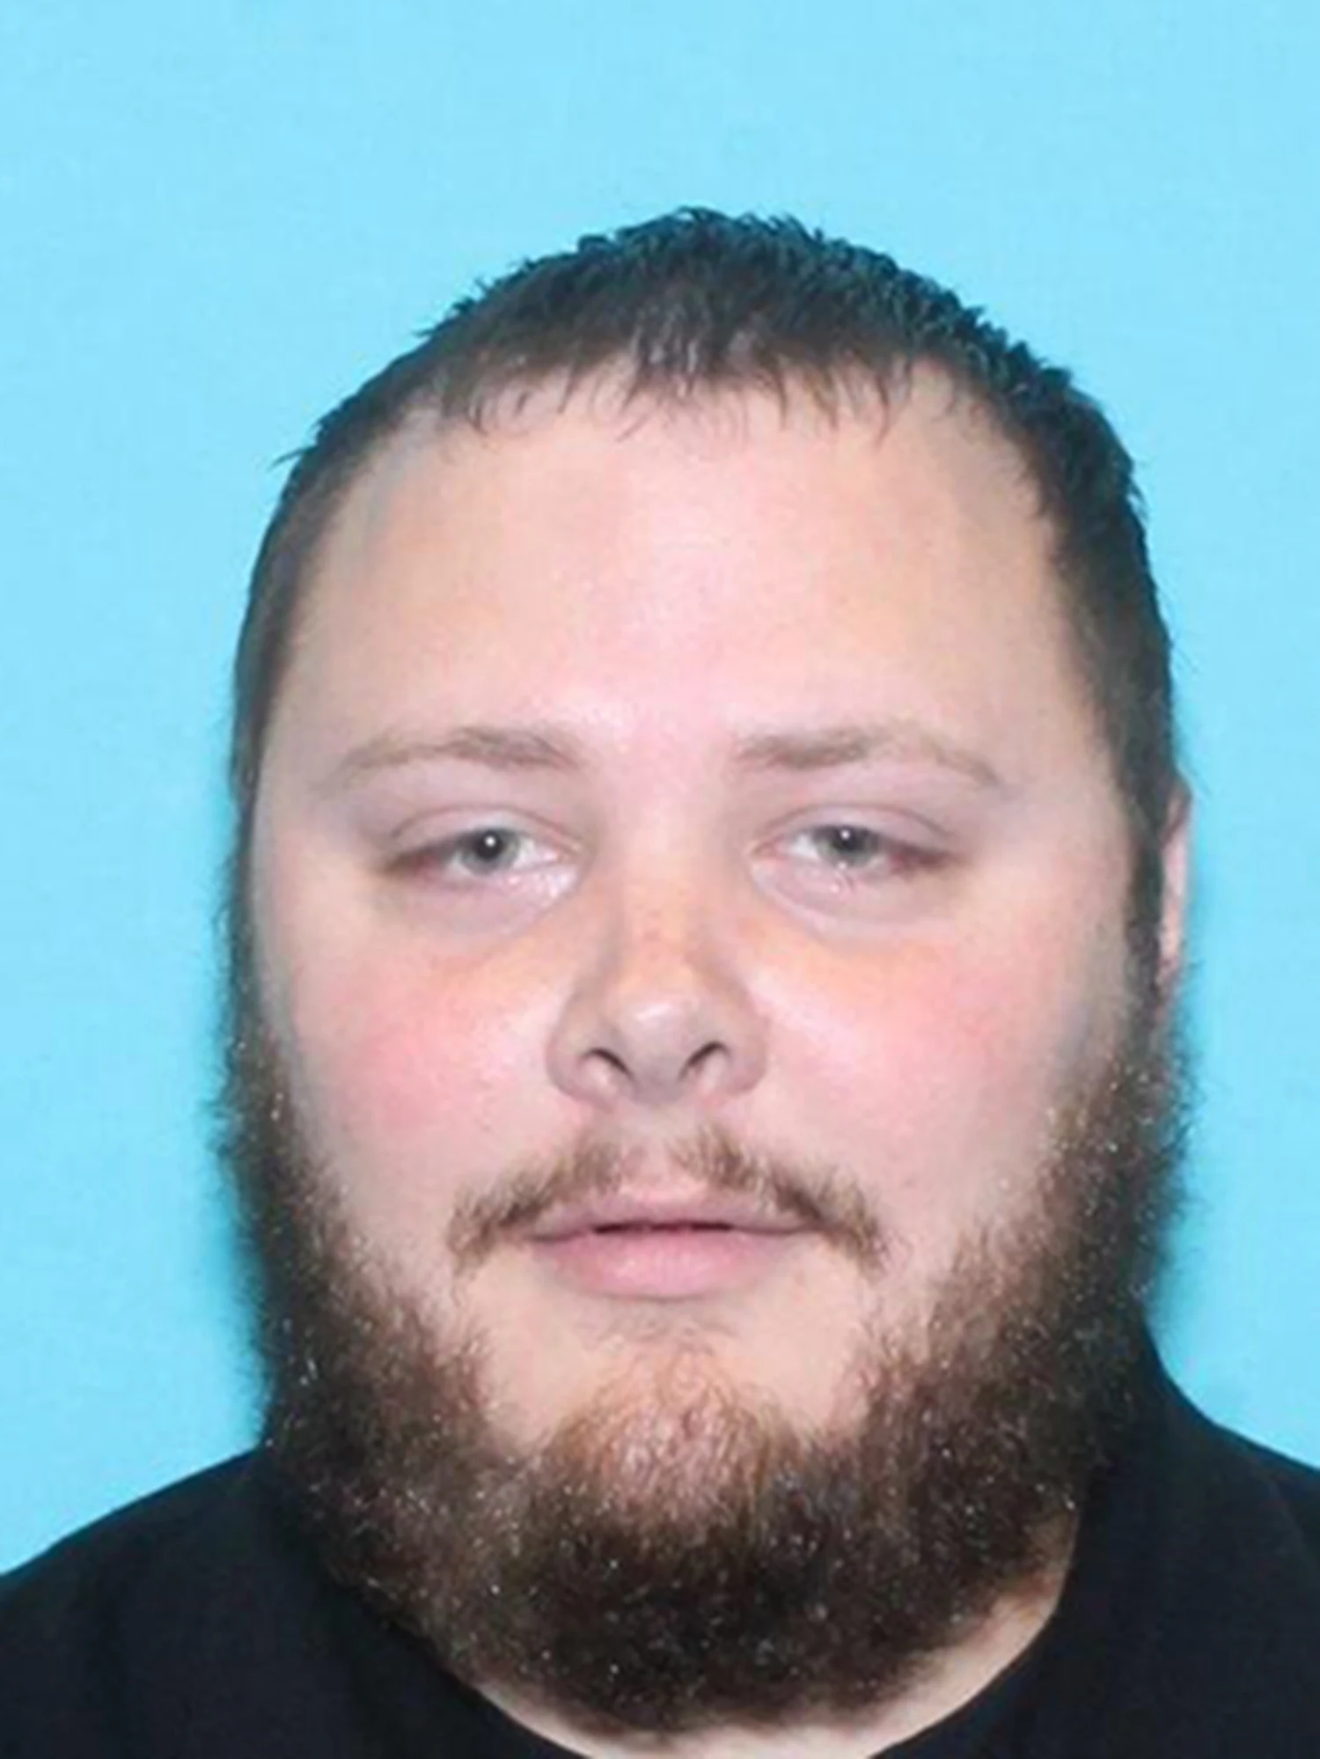
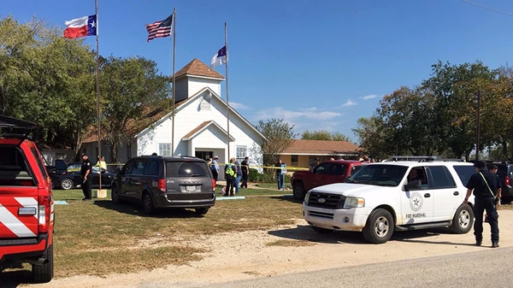
Active Shooter Response
Keegan Bradley MD, FACEP, FAWM

Slide 2
Background
Emergency Medicine Physician
Medical City McKinney, McKinney, TX
Medical Director- McKinney Fire/Rescue
Medical Director- Lucas Fire/Rescue
Medical Team Manager- Texas A&M Task Force 1
REP-C Co-Medical Director for Texas Emergency Medical Task Force Region 2
Vice Chair, Section of Tactical Emergency Medicine, ACEP
Sheriff Deputy/Assistant Medical Director for Collin County Sheriff Dept

Slide 3

Not “if”, but “when”
What is an active shooter: an individual(s) actively engaged in killing or attempting to kill people in a confined and populated area
2022:
  313 casualties
  50 active shooter incidents (down 18% from 2021)
  Texas had most incidents (6)
  46% in open spaces, 28% in commerce, 8% in education, 4% in houses of worship, 2% healthcare
  61 firearms used: 29 handgun, 26 rifle, 3 shotgun, 3 unknown
  29 shooters arrested, 7 killed by LE, 2 killed by armed citizens, 9 committed suicide, 3 still at large
  48% of shooters had connection with location or at least one victim
https://www.fbi.gov/file-repository/active-shooter-study-2000-2013-1.pdf/view
file:///C:/Users/kbrad/Downloads/active-shooter-incidents-in-the-us-2022-042623.pdf

Slide 4
https://www.youtube.com/watch?v=53hleVLARbE

Slide 5
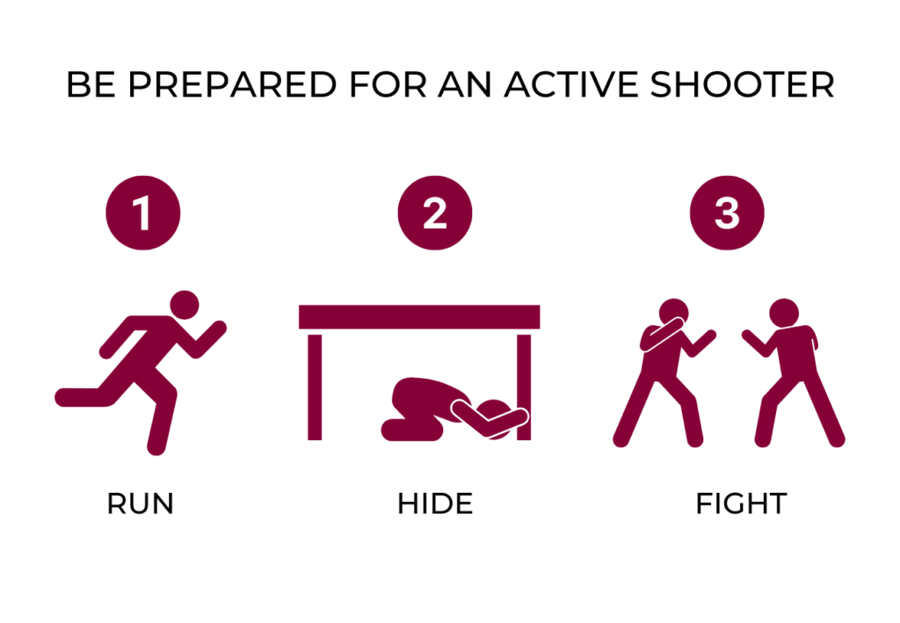
What to do?
Many organizations currently teach the “Run, Hide, Fight” approach
These three tactics can be used to prepare and empower someone to survive an active shooter situation
There are certain things to be aware of when law enforcement arrives on scene
https://youtu.be/TeOdxKozra0

Slide 6
How to Help
One does not have to always be only a survivor
There are skills people can learn to not only survive, but SAVE others
First and most important make sure you are safe
Next call 911 (if able to)
If you cannot escape or it is safe to do, assess if someone needs care
Provide first aid
DO NOT go looking for victims
Stop the bleed, TECC, CPR, AED’s, many other resources
https://www.stopthebleed.org/
https://www.heart.org/
https://www.dontnamethem.org/

